Slide 1








FOOD CHOICES
College students' food and cooking preferences

Slide 2




UMRAH
GROUP MEMBERS
SURAJ S YADHAV
NIKHITHA ELEZEBETH BABY

Slide 3
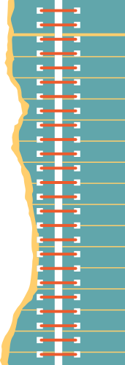


ABOUT THE DATASET
This dataset includes information on food choices, nutrition, preferences, childhood favorites, and other information from college students. There are 125 responses from students.Data initially raw and uncleaned. Data comes from Kaggle.
How important is nutrition information for today's college kids? Is their taste in food defined by their food preferences when they were children? Are kids of parents who cook more likely to make better food choices than others? Are these kids likely to have a different taste compared to others?

Slide 4
ABOUT THE DATASET
There were many open ended questions as columns in the dataset. Some columns are even repeated in the dataset.
The dataset contained missing values which were replaced used mean and mode values. After cleaning, the dataset contains 45 columns.
The survey is conducted among the students of Mercyhurst University

Slide 5
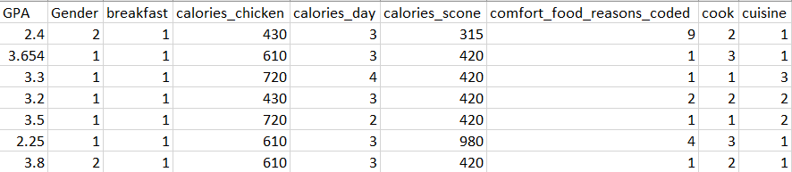
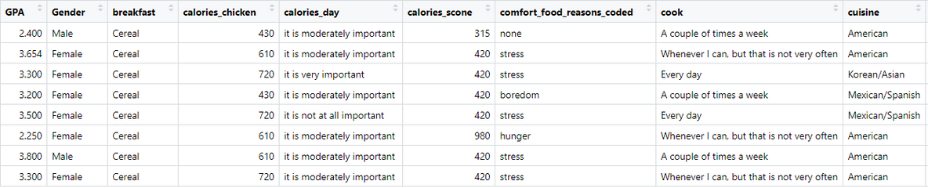
The dataset is a survey conducted on students. Therefore the responses are marked as numbers starting from 1. Changes are made to the variables that seem to be categorical in nature for the purpose of visualization. The numerical values are changed to their name.

Slide 6
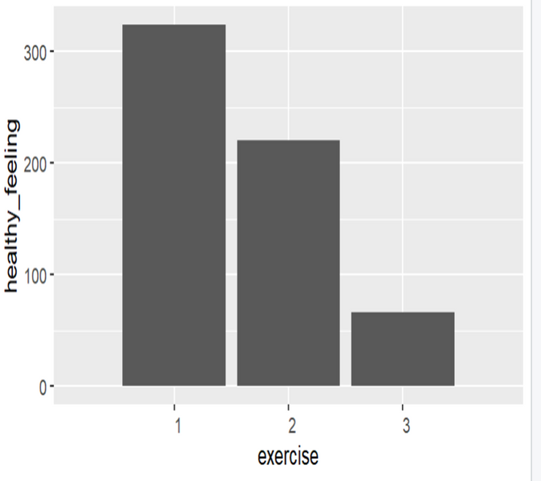
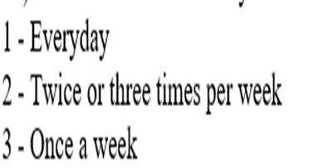

Slide 7
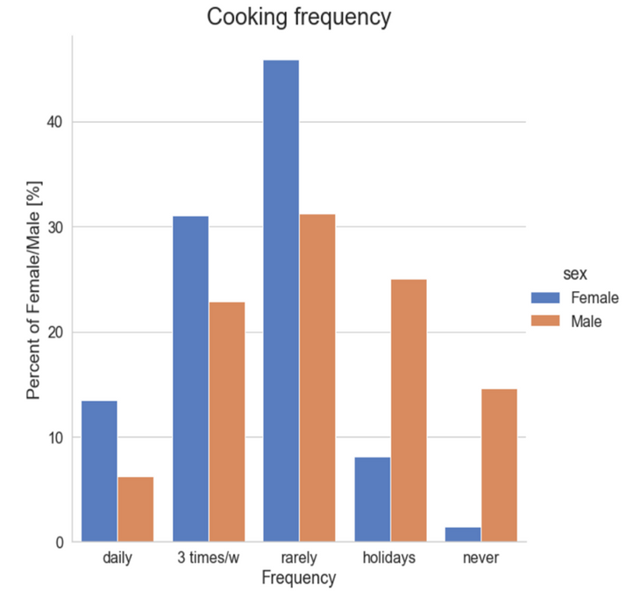
We can see that females cook
more frequently than males.
'Holidays' and 'never’
categories are rather opposite to
cooking in the academic year
where males have fully
dominance over females

Slide 8
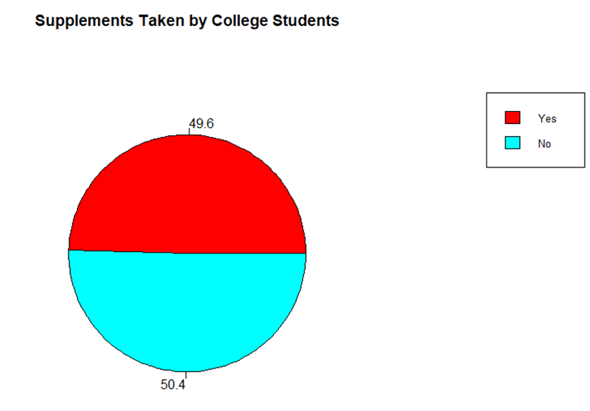
Roughly more than half of adults in United States take multivitamins or other dietary supplements.

Slide 9
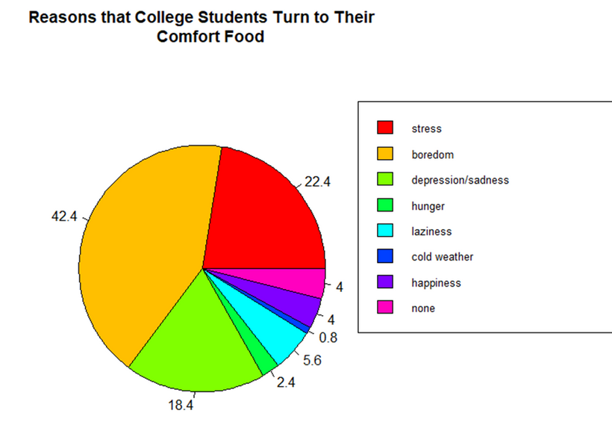
Comfort food provides consolation or a feeling of well-being, typically having a high sugar or carbohydrate content.

Slide 10
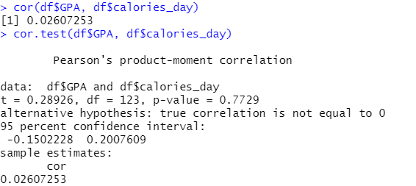
The value of 0.02 shows a positive but weak linear relationship between the two variables GPA and calories_day.
Since the p-value of 0.7729 is greater than 0.05, we fail to reject the null hypothesis that the relationship between GPA and calories_day is significant.
Hence we can say students with a higher GPA are more aware of the calories they should consume
per day.

Slide 11
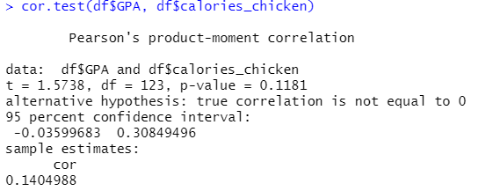
The value of 0.1404988shows a positive linear relationship between the two variables GPA and calories_chicken.
Since the p-value of 0.1181 is greater than 0.05, we fail to reject the null hypothesis that the relationship between GPA and calories_chicken is significant.
Students with a higher GPA guess more accurately about the calories
present in various foods(for eg chicken).

Slide 12
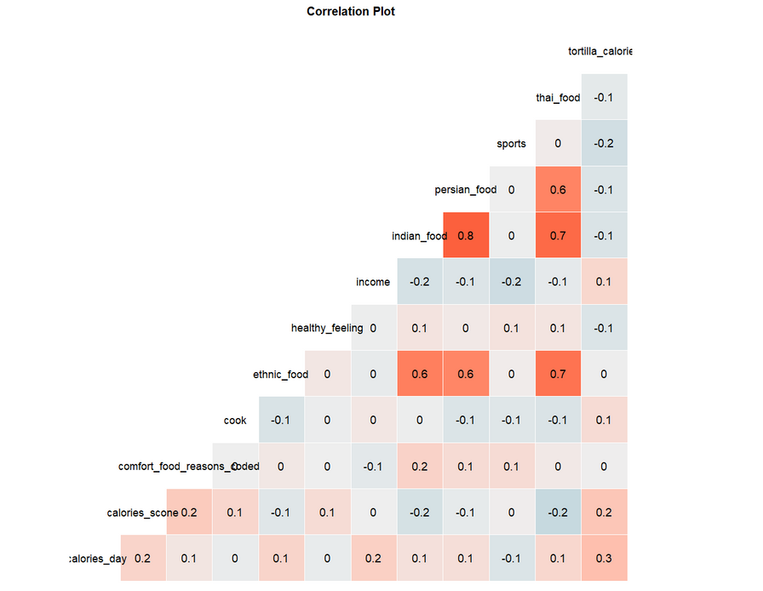
From the correlation plot we can say that Indian food and Persian food are highly correlated as compared to other foods i.e Students who prefer Indian food also prefer Persian food.

Slide 13




Thank you!

